Slide 1
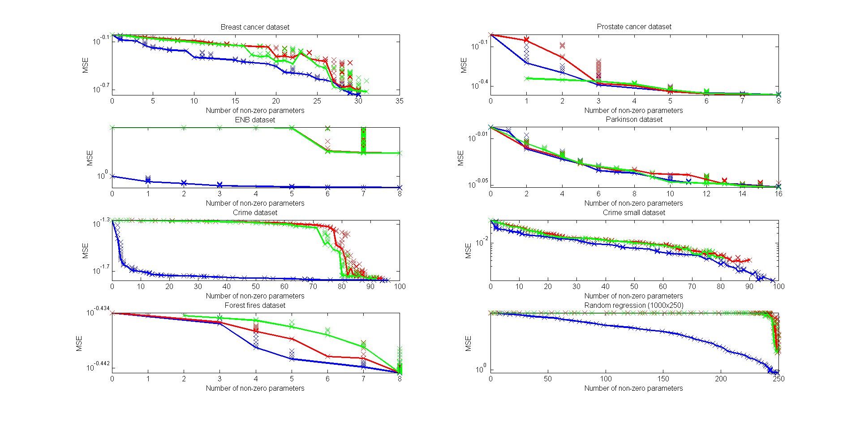
th = min(thInterval,thMinCoeff);

Slide 2
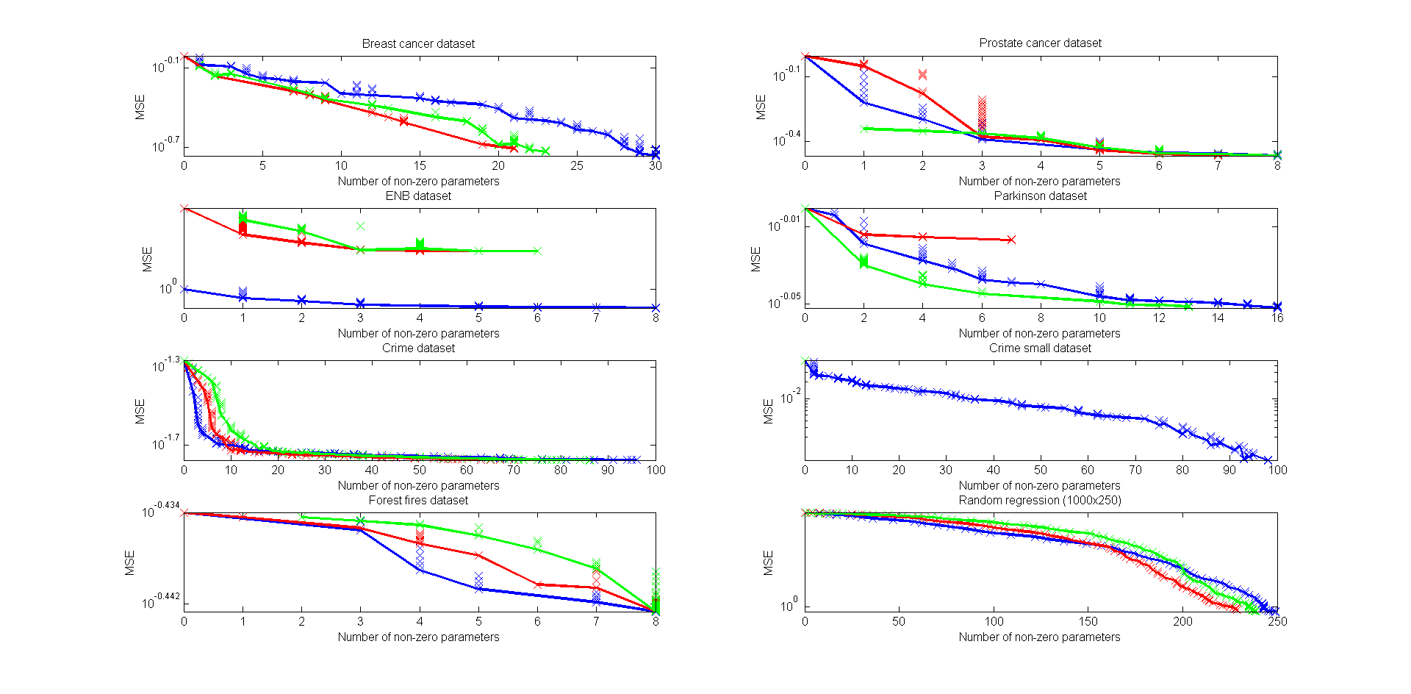
th = thInterval;

Slide 3
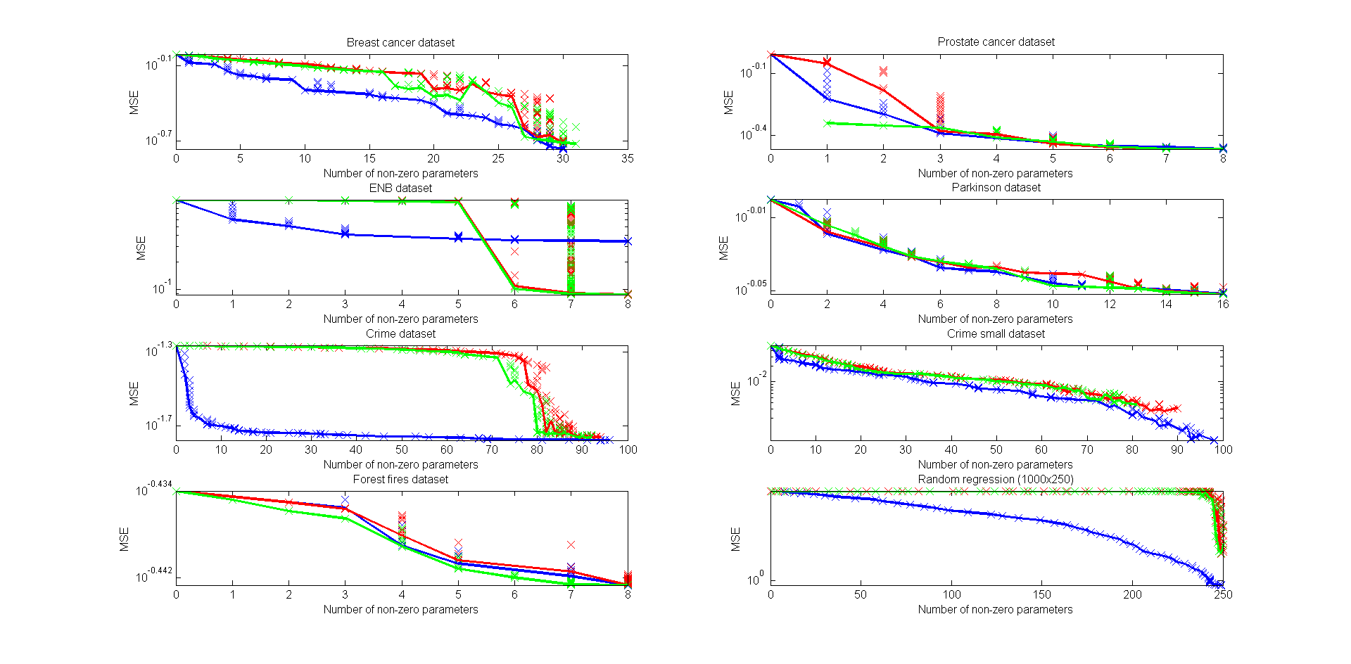
th = thMinCoeff;

Slide 4
MATLAB lasso
PQSQ
PQSQ with trimming

